Slide 1
Grid Computing

Slide 2
Outline
Introduction to Grid Computing
Methods of Grid computing
Grid Middleware
Grid Architecture

Slide 3
Introduction To Grid Computing
Grid computing is the combination of computer resources from multiple administrative domains for a common goal.
Grid computing is a form of distributed computing whereby a "super and virtual computer" is composed of a cluster of networked, loosely coupled computers, acting in concert to perform very large tasks.
Grid computing is a growing technology that facilitates the executions of large-scale resource intensive applications on geographically distributed computing resources. (By Foster and Kesselman, 1999)

Slide 4
Introduction to grid computing (cont.)
The collaborative effort of many different groups bringing all together is known as “Virtual Organizations" (VO's).
They may be formed to solve a single task and may then disappear just as quickly.
Grids are usually used for solving scientific, technical or business problems that require a great number of computer processing cycles and/or need the processing of large amounts of data.
Facilitates flexible, secure, coordinated large scale resource sharing among dynamic collections of individuals, institutions, and resource

Slide 5
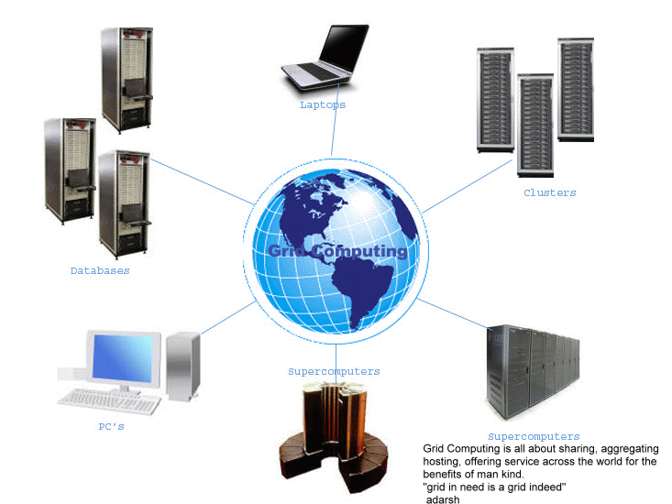

Slide 6
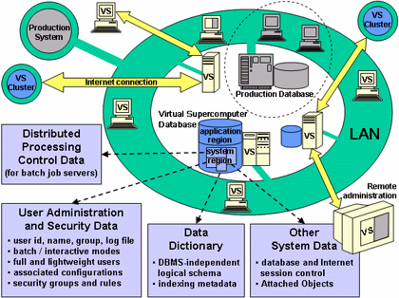

Slide 7
Why Grid Computing?
40% Mainframes are idle
90% Unix servers are idle
95% PC servers are idle
0-15% Mainframes are idle in peak-hour
70% PC servers are idle in peak-hour

Slide 8
Criteria for a Grid Computing
  Coordinates resources that are not subject to centralized control.
  Uses standard, open, general-purpose protocols and interfaces.
  Delivers nontrivial qualities of service.

Slide 9
Benefits
  Exploit Underutilized resources
  Resource load Balancing
  Virtualized resources across an enterprise
  Data Grids, Compute Grids
  Enable collaboration for virtual organizations

Slide 10
Grid Applications
Data and computationally intensive applications:
This technology has been applied to computationally-intensive scientific, mathematical, and academic problems like drug discovery, economic forecasting, seismic analysis back office data processing in support of e-commerce
A chemist may utilize hundreds of processors to screen thousands of compounds per hour.
Teams of engineers worldwide pool resources to analyze terabytes of structural data.
Meteorologists seek to visualize and analyze petabytes of climate data with enormous computational demands.

Slide 11
Resource sharing
Computers, storage, sensors, networks, …
Sharing always conditional: issues of trust, policy, negotiation, payment, …
Coordinated problem solving
distributed data analysis, computation, collaboration, …

Slide 12
Grid Topologies
Intragrid
Local grid within an organization
Trust based on personal contracts
Extragrid
Resources of a consortium of organizations connected through a (Virtual) Private Network
Trust based on Business to Business contracts
Intergrid
Global sharing of resources through the internet
Trust based on certification

Slide 13
Computational Grid
A computational grid is a hardware and software infrastructure that provides dependable, consistent, pervasive, and inexpensive access to high-end computational capabilities.
Example : Science Grid (US Department of Energy)

Slide 14
Data Grid
A data grid is a grid computing system that deals with data — the controlled sharing and management of large amounts of distributed data.
Data Grid is the storage component of a grid environment. Scientific and engineering applications require access to large amounts of data, and often this data is widely distributed. A data grid provides seamless access to the local or remote data required to complete compute intensive calculations.
Example :
Biomedical informatics Research Network (BIRN)
Southern California earthquake Center (SCEC)

Slide 15
Methods of Grid Computing
Distributed Supercomputing
High-Throughput Computing
On-Demand Computing
Data-Intensive Computing
Collaborative Computing
Logistical Networking

Slide 16
Distributed Supercomputing
Combining multiple high-capacity resources on a computational grid into a single, virtual distributed supercomputer.
Tackle problems that cannot be solved on a single system.

Slide 17
High-Throughput Computing
Uses the grid to schedule large numbers of loosely coupled or independent tasks, with the goal of putting unused processor cycles to work.

Slide 18
On-Demand Computing
Uses grid capabilities to meet short-term requirements for resources that are not locally accessible.
Models real-time computing demands.

Slide 19
Collaborative Computing
Concerned primarily with enabling and enhancing human-to-human interactions.
Applications are often structured in terms of a virtual shared space.

Slide 20
Data-Intensive Computing
The focus is on synthesizing new information from data that is maintained in geographically distributed repositories, digital libraries, and databases.
Particularly useful for distributed data mining.

Slide 21
Logistical Networking
Logistical networks focus on exposing storage resources inside networks by optimizing the global scheduling of data transport, and data storage.
Contrasts with traditional networking, which does not explicitly model storage resources in the network.
high-level services for Grid applications
Called "logistical" because of the analogy it bears with the systems of warehouses, depots, and distribution channels.

Slide 22


A typical view of Grid environment
Grid Information Service
Grid Information Service system collects the details of the available Grid resources and passes the information to the resource broker.
Details of Grid resources
Computational jobs
Grid application
Processed jobs
Computation result
User
Resource Broker
A User sends computation or data intensive application to Global Grids in order to speed up the execution of the application.
A Resource Broker distribute the jobs in an application to the Grid resources based on user’s QoS requirements and details of available Grid resources for further executions.
Grid Resources
Grid Resources (Cluster, PC, Supercomputer, database, instruments, etc.) in the Global Grid execute the user jobs.

Slide 23
Grid Middleware
Grids are typically managed by grid ware -
a special type of middleware that enable sharing and manage grid components based on user requirements and resource attributes (e.g., capacity, performance)
Software that connects other software components or applications to provide the following functions:
  Run applications on suitable available resources
– Brokering, Scheduling
  Provide uniform, high-level access to resources
– Semantic interfaces
– Web Services, Service Oriented Architectures
  Address inter-domain issues of security, policy, etc.
– Federated Identities
  Provide application-level status
  monitoring and control

Slide 24
Middleware
Globus –chicago Univ
Condor – Wisconsin Univ – High throughput computing
Legion – Virginia Univ – virtual workspaces- collaborative computing
IBP – Internet back pane – Tennesse Univ – logistical networking
NetSolve – solving scientific problems in heterogeneous env – high throughput & data intensive

Slide 25
Grid Architecture

Slide 26
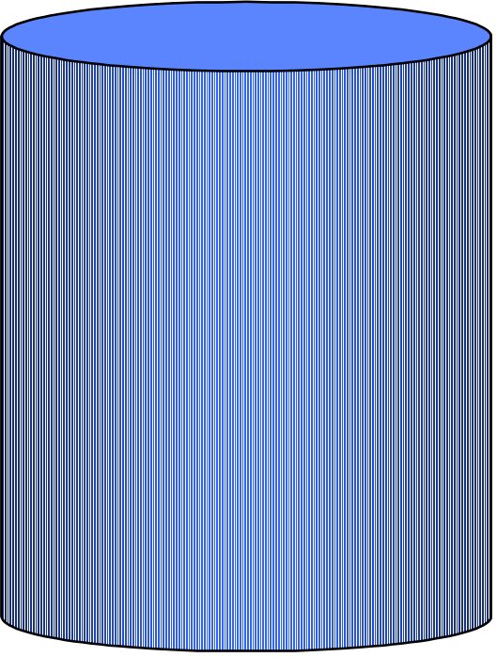
The Hourglass Model
Focus on architecture issues
Propose set of core services as basic infrastructure
Used to construct high-level, domain-specific solutions (diverse)
Design principles
Keep participation cost low
Enable local control
Support for adaptation
“IP hourglass” model
Applications
Diverse global services
Core
services
Local OS

Slide 27
Layered Grid Architecture
(By Analogy to Internet Architecture)
Application
Application
Internet Protocol Architecture
“Coordinating multiple resources”: ubiquitous infrastructure services, app-specific distributed services
Collective
“Sharing single resources”: negotiating access, controlling use
Resource
“Talking to things”: communication (Internet protocols) & security
Connectivity
Transport
Internet
“Controlling things locally”: Access to, & control of, resources
Fabric
Link

Slide 28
Example:
Data Grid Architecture
Layer | Example
Application | Discipline-Specific Data Grid Application
Collective (App) | Coherency control, replica selection, task management, virtual data catalog, virtual data code catalog, …
Collective (Generic) | Replica catalog, replica management, co-allocation, certificate authorities, metadata catalogs,
Resource | Access to data, access to computers, access to network performance data, …
Connect | Communication, service discovery (DNS), authentication, authorization, delegation
Fabric | Storage systems, clusters, networks, network caches, …

Slide 29
Key Technologies
OGSA: Open Grid Services Architecture
Web services: XML, WSDL, SOAP

Slide 30
Open Grid Services Architecture
OGSA architecture with Web services-enabled service interface
Applications
Web Services
OGSA
Security
Workflow
Database
File
systems
Directory
Messaging
Servers
Storage
Network

Slide 31
Communities
Global Grid Forum
The Globus Alliance: Globus Toolkit 4.0

